Slide 1
The Innovative Pro Assistant
Butrind Zekaj & Oliver Richani

Slide 2
UML Innovative Pro Use Case Diagram

Slide 3
UML Class Diagram

Slide 4
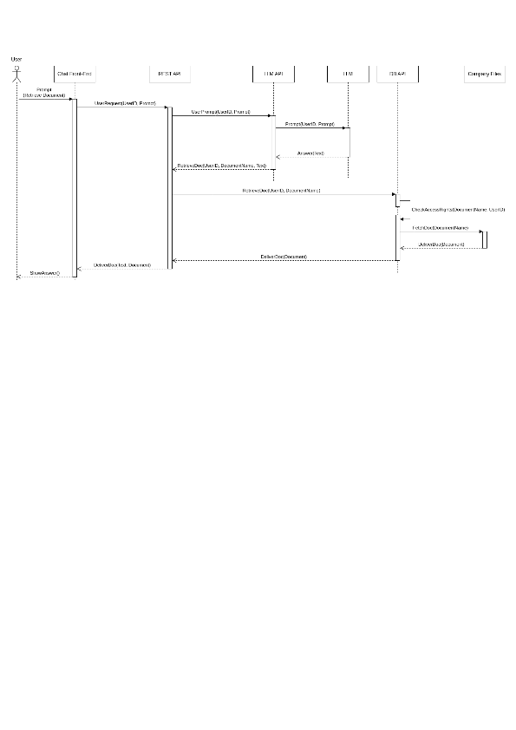
UML Sequence Diagram (1) Feature 1 : Retrieve a document

Slide 5
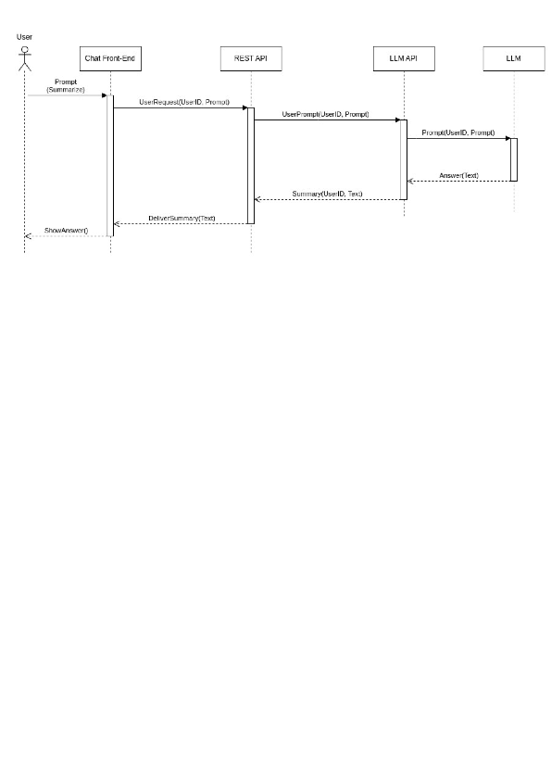
UML Sequence Diagram (2) Feature 2 : Summarize a document

Slide 6
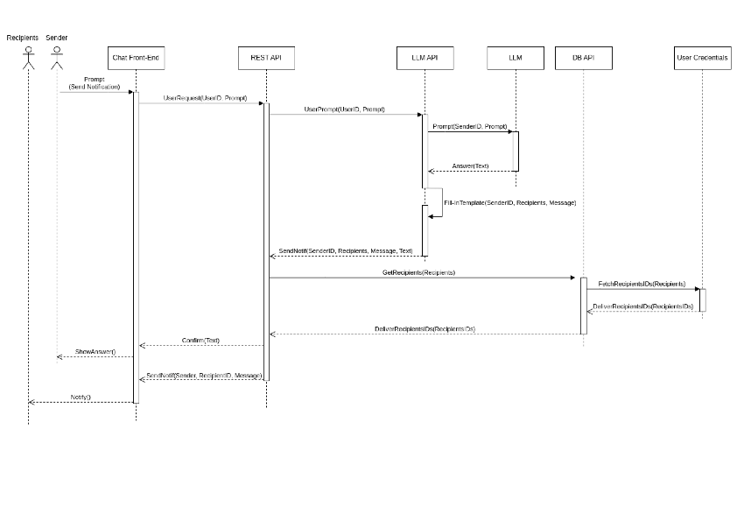
UML Sequence Diagram (3) Feature 3 : Send notifications

Slide 7
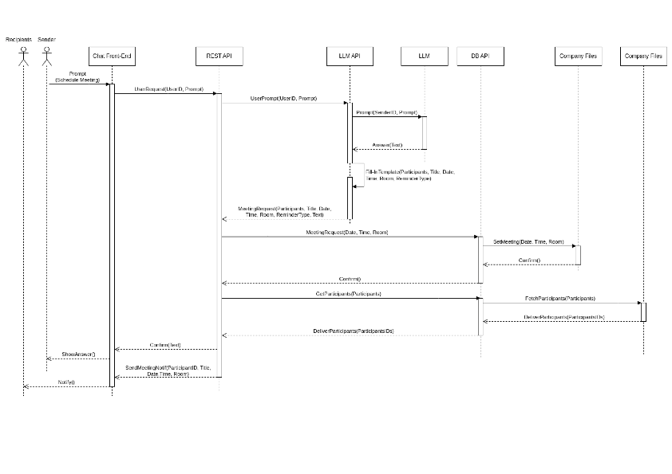
UML Sequence Diagram (4) Feature 4 : Schedule

Slide 8
Prototype (1)

Slide 9
Prototype (2)

Slide 10
Prototype (3)

